Slide 1
背景執行、動態磚與通知
簡報者

Slide 2
背景執行
動態磚
通知

Slide 3
背景執行

Slide 4
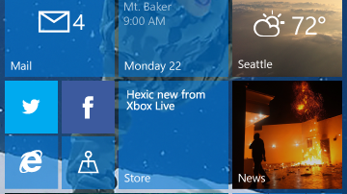
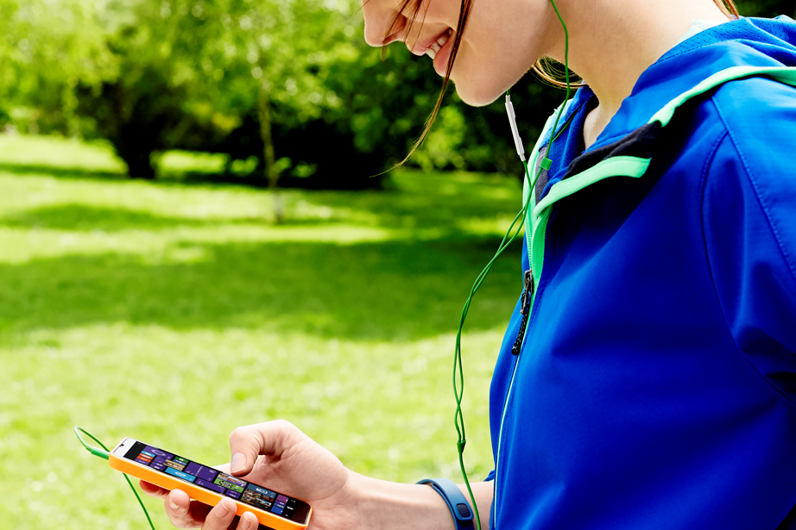
背景執行
當 app 暫停執行時仍能處理資料
Draw users into your app
Delight them with features

Slide 5
在您的 app 未執行時執行的工作

Slide 6
建立背景工作
注意背景工作的繁忙程度
BackgroundWorkCostValue.High 表示這個背景工作不應該被啟動
要能處理被取消的操作
背景工作可能會被使用者或系統停止工作
天生就是非同步執行
不必特別使用非同步程式寫法來做
回報工作進度
工作進度是數值

Slide 7
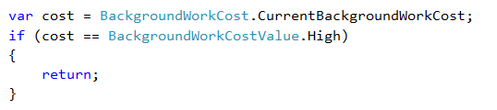
注意背景工作的繁忙程度
確認系統繁忙程度可以避免有些工作被取消

Slide 8
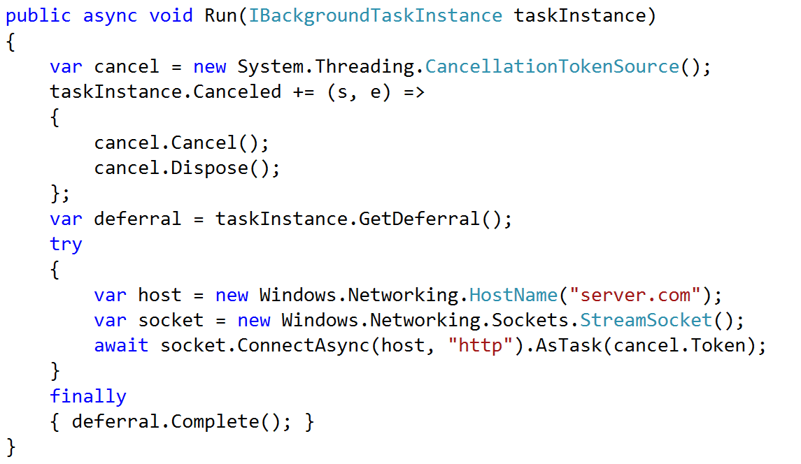
要能處理被取消的操作
系統資源不足時會取消背景工作

Slide 9
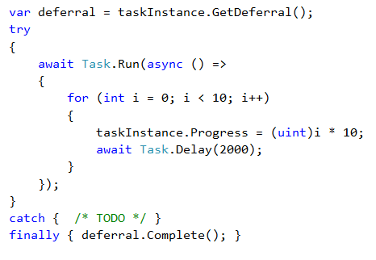
非同步執行

Slide 10
一個 app 可以同時執行多個背景工作

Slide 11
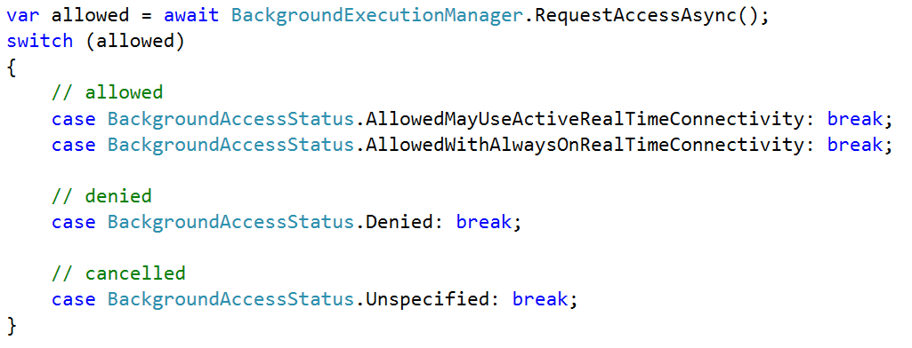
取得執行背景工作的權限

Slide 12
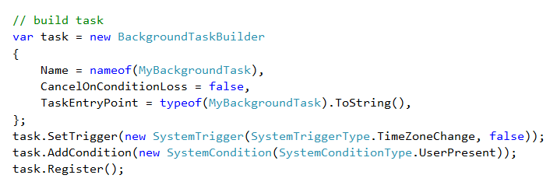
建立並註冊背景工作

Slide 13
執行工作 = 觸發程序 + [條件]

Slide 14
背景觸發程序[ when? ]
SystemTrigger
TimeTrigger
MaintenanceTrigger
DeviceUseTrigger
DeviceServicingTrigger
PushNotificationTrigger
AppointmentStoreNotificationTrigger
ContactStoreNotificationTrigger
EmailStoreNotificationTrigger
BluetoothLEAdvertisementWatcherTrigger
BluetoothLEAdvertisementPublisherTrigger
DeviceWatcherTrigger
ActivitySensorTrigger
SensorDataThresholdTrigger
ToastNotificationHistoryChangedTrigger
ToastNotificationActionTrigger
ApplicationTrigger
MediaProcessingTrigger
SocketActivityTrigger
Windows 8.1
Windows 10
CachedFileUpdaterTrigger
DeviceConnectionChangeTrigger
GattCharacteristicNotificationTrigger
RfcommConnectionTrigger
LocationTrigger
Phone 8.1

Slide 15
觸發程序週期最短 15 分鐘

Slide 16
About the maintenance trigger
Requires A/C power
If unplugged, it will be cancelled
Requires Wi-Fi connection
Requires lock screen access
Is a long-running task
Not guaranteed to run
Can be cancelled
Parameters
Freshness (15 minutes or more)
One shot (repeating)

Slide 17
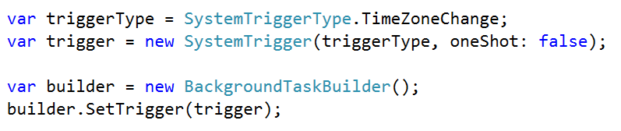
新增一個觸發程序

Slide 18
執行工作 = 觸發程序 + [條件]

Slide 19
系統條件 [ if? ]
User Present
If the user is present
User Not Present
If the user is not present
Internet Available
If the internet is available
Internet Not Available
If the internet is not available
Session Connected
If the user is logged in
Session Disconnected
If the user is not logged in
Free Network Available
If a non-metered network is available
Work Cost Not High
If background resources are plentiful

Slide 20
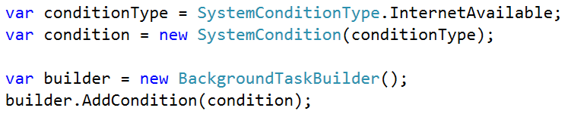
使用條件註冊背景工作

Slide 21
背景工作一旦觸發，就會等待所有的條件成立才執行

Slide 22
Managing your Background resources

Slide 23
工作限制
CPU time quota = NO
CPU guarantee = YES (10%)
Wall clock quota = YES (25s + 5s)
Except for long-running tasks
Memory quota = YES
Variable by device, min 16MB
Network quota = YES
Variable by device

Slide 24
每次觸發程序啟動時，用量就會重新計算

Slide 25
資源管理
Memory
Default tasks
保證最少可執行 25 秒
Run (25 seconds)
Cancel (5 seconds)
Memory
長時間執行的工作
只要資源許可都能執行
Includes: Application, Maintenance, and DeviceUse triggers
Run (no end)
End (no warning, for now)

Slide 26
背景工作隨時都有可能被系統取消（有 5 秒時間處理）

Slide 27
背景工作如何偵錯
Visual Studio can trigger
Application log
Application & Services Logs > Microsoft > BackgroundTaskInfrastructure
PowerShell cmdlets
Test with global pool disabled
Set-AppBackgroundTaskResourcePolic –Mode Conservative
See resource usage
Get-AppBackgroundTask -ResourceUsage

Slide 28
動態磚

Slide 29


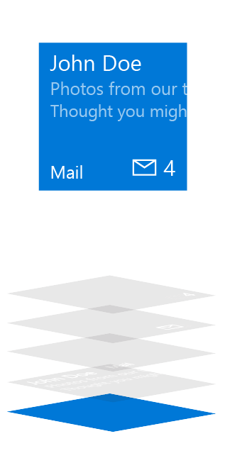
動態磚類型
Basic State
Semi-Live State
Live State
Plate
Plate
Plate
Content
App Logo
App Logo
App Icon
Badge
Badge
Short Name
Short Name
Short Name
Badge
Badge
App Icon
Short Name
Short Name
Short Name
App Logo
App Logo
Content
Plate
Plate
Plate

Slide 30
更新動態磚內容
Scheduled
Set template and time with “ScheduledTileNotification”
Periodic
Pull from URL 30m / 60m / 6h / 12h / 24h
Local
Update from (foreground/background) app
Push
Use push services
Update badge

Slide 31
更新動態磚 badge
// build badge
var type = BadgeTemplateType.BadgeNumber;
var xml = BadgeUpdateManager.GetTemplateContent(type);
// updte element
var elements = xml.GetElementsByTagName("badge");
var element = elements[0] as Windows.Data.Xml.Dom.XmlElement;
element.SetAttribute("value", "47");
// send to lock screen
var updator = BadgeUpdateManager.CreateBadgeUpdaterForApplication();
var notification = new BadgeNotification(xml);
updator.Update(notification);

Slide 32
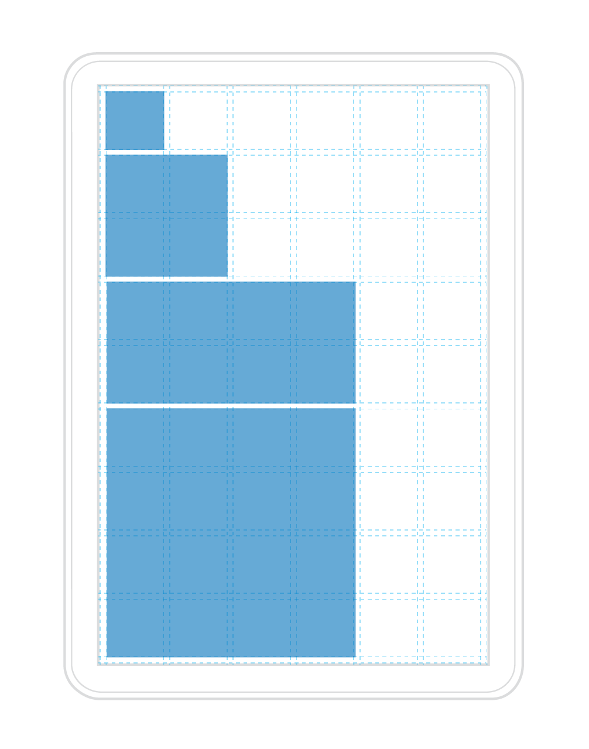
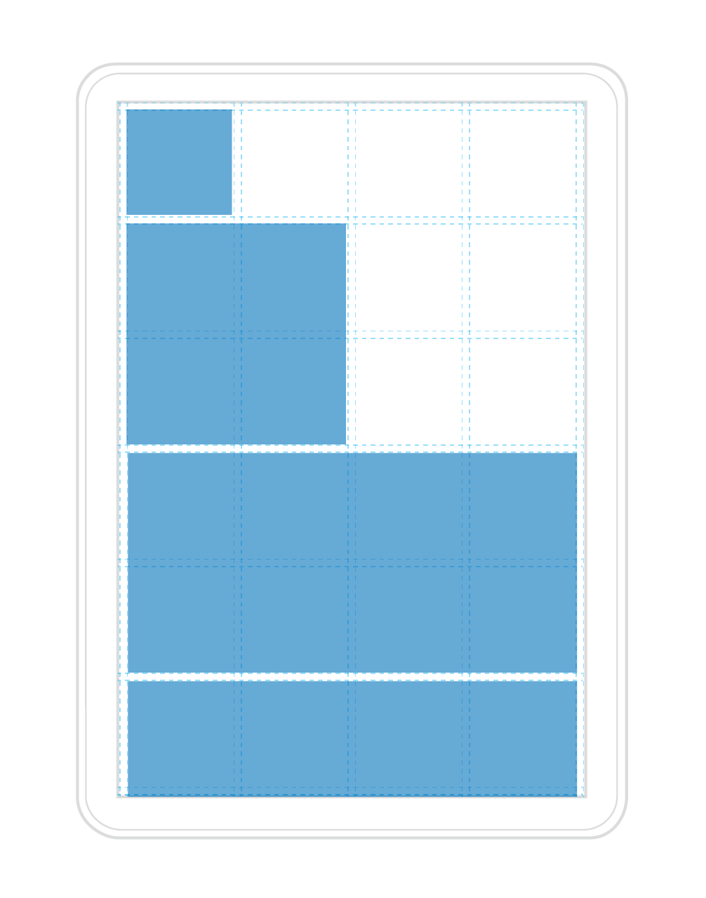
響應式動態磚
Low density example
High density example
Tiles are not always the same size
Tiles adapt to the screen they are on
Since the Start grid has different densities
and adapts to the screen size of your device,
so do our tiles and the content within them.

Slide 33
動態磚範本

Slide 34
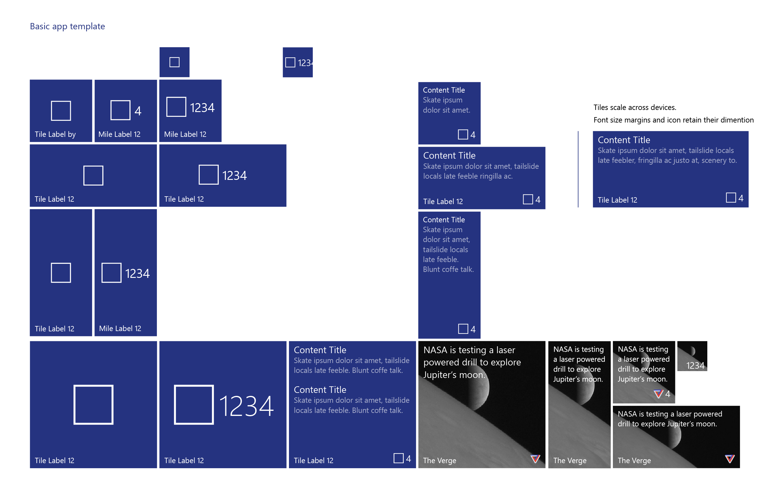

Slide 35
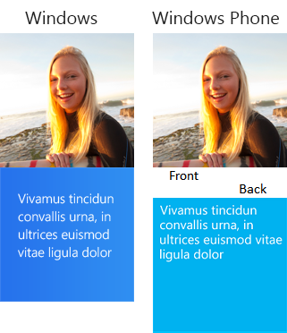
傳統的範本
If a template meets your needs, go ahead and use it.
Previous templates remain
Phone and Windows templates have been merged
There are over 80 templates available

Slide 36
建立 SecondaryTile
var tileId = "DetailsTile";
var pinned = SecondaryTile.Exists(tileId);
if (!pinned)
{
var tile = new SecondaryTile(tileId)
{
DisplayName = "Record details",
Arguments = "123"
};
// extra details
var success = await tile.RequestCreateAsync();
}

Slide 37
使用 secondary tiles 來處理深度連結 (deep-link)

Slide 38
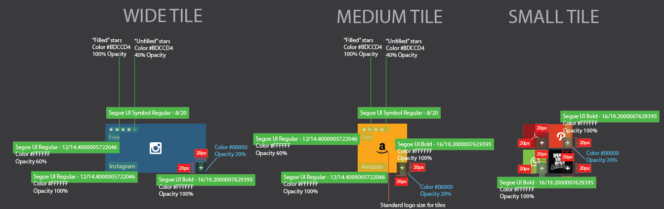

Slide 39
自適應 (adaptive) 範本

Slide 40
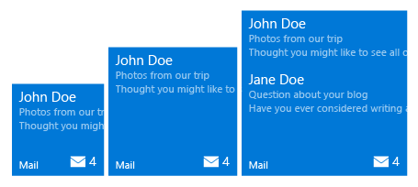
Adaptive tiles
<tile>
<visual>
<binding template="TileMedium">
<group> <subgroup>
<text hint-style="subtitle">John Doe</text>
<text hint-style="subtle">Photos from our trip</text>
<text hint-style="subtle">Thought you might…</text>
</subgroup>
</group>
<group> <subgroup>
…
</subgroup>
</group>
</binding>
</visual>
</tile>
Min. Med Size
Max Med. Size

Slide 41
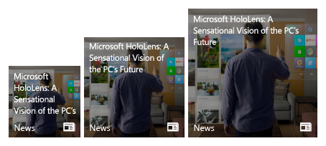
Adaptive tiles
<tile>
<visual>
<binding template="TileMedium">
<image source="Assets\image.png" placement="background" />
<text hint-wrap="true">
Microsoft HoloLens: A
Sensational Vision of the PC’s Future
</text>
</binding>
</visual>
</tile>
Min. Med Size
Max Med. Size

Slide 42
Adaptive samples

Slide 43
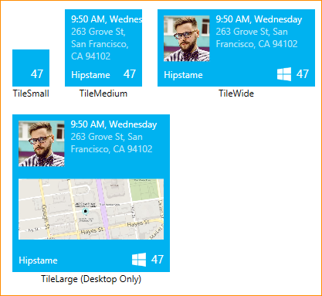
Sample: Small Tile
<binding template="TileSmall"
branding="none" hint-textStacking="center">
</binding>

Slide 44
Sample 1: Medium Tile
<binding template="TileMedium"
branding="Name" displayName="Hipstame">
<text hint-style="caption">
9:50 AM, Wednesday</text>
<text hint-style="captionsubtle" hint-wrap="true">
263 Grove St, San Francisco, CA 94102</text>
</binding>

Slide 45
Sample: Wide Tile
<binding template="TileWide" displayName="Hipstame">
<group>
<subgroup hint-weight="33">
<image placement="inline" src="http://image.jpg" />
</subgroup>
<subgroup>
<text hint-style="caption">
9:50 AM, Wednesday</text>
<text hint-style="captionsubtle"
hint-wrap="true" hint-maxLines="3">
263 Grove St, San Francisco, CA 94102</text>
</subgroup>
</group>
</binding>

Slide 46
Sample: Large Tile
<binding template="TileLarge" displayName="Hipstame">
<group>
<subgroup hint-weight="33">
<image placement="inline" src="http://image.jpg" />
</subgroup>
<subgroup>
<text hint-style="caption">
9:50 AM, Wednesday</text>
<text hint-style="captionsubtle"
hint-wrap="true" hint-maxLines="3">
263 Grove St, San Francisco, CA 94102</text>
</subgroup>
</group>
<image placement="inline" src="http://map.jpg"/>
</binding>

Slide 47
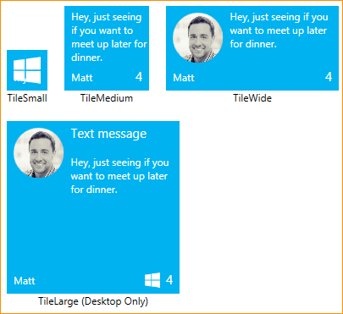
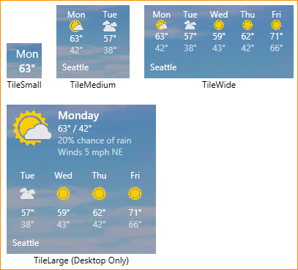
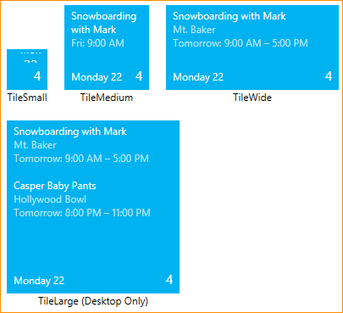
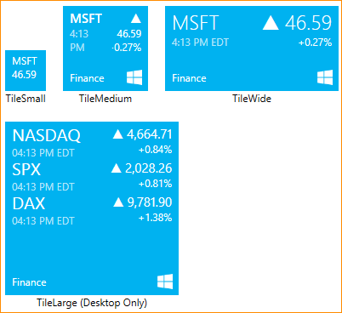
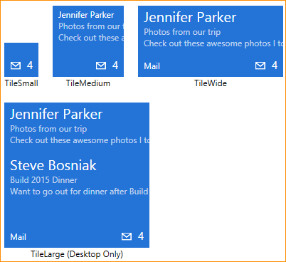
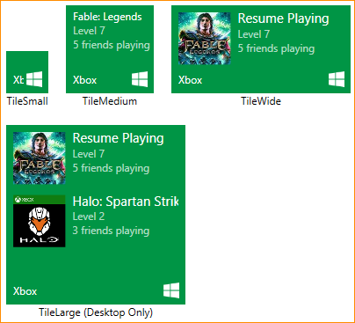
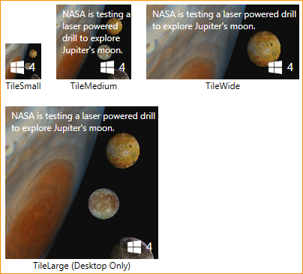
Adaptive
Templates

Slide 48
Toast 通知

Slide 49
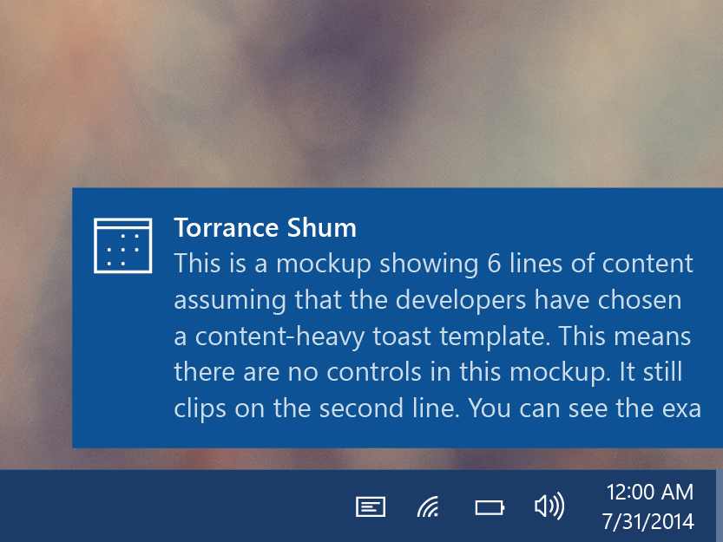
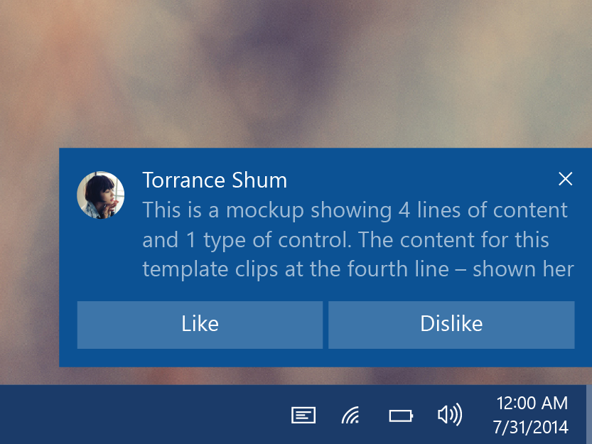
Toasts
Glance (consume)
See new information from your apps.
Act (chase, or take actions)
Toasts invite you to begin or complete a task.
The toast is the app’s door by chasing (clicking) it.
Additional actions enable users to perform simple tasks without context switching.

Slide 50
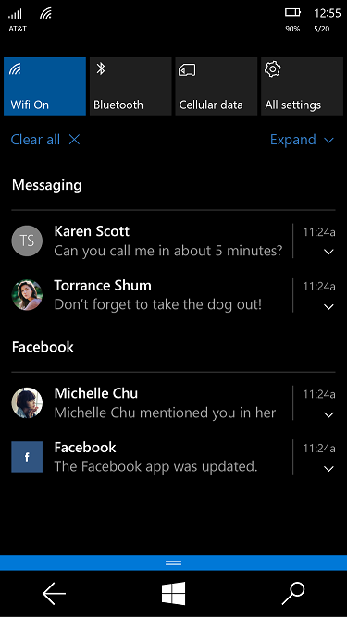
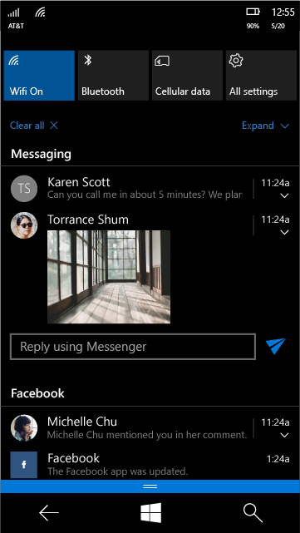
Toast states
Collapsed state
Action center chevron
Mobile default
Expanded state
Action center chevron
Desktop default

Slide 51
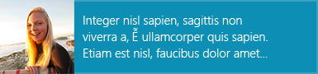
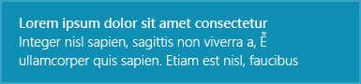
Toast 範本
If a template meets your needs, go ahead and use it.
Previous templates remain
Phone and Windows templates have been merged
Adaptive template
Same XML syntax as tiles

Slide 52
送出 toast 通知
Scheduled
Set template and time with “ScheduledToastNotification”
Toast can also be set to be recurring.
Local
Send from (foreground/background) app
This includes desktop apps with “AppUserModelID”
Push
Use push services

Slide 53
Sending toast
// build toast
var template = ToastTemplateType.ToastText01;
var xml = ToastNotificationManager.GetTemplateContent(template);
xml.DocumentElement.SetAttribute("launch", "Args");
// set value
var text = xml.CreateTextNode(content);
var elements = xml.GetElementsByTagName("text");
elements[0].AppendChild(text);
// show toast
var toast = new ToastNotification(xml);
var notifier = ToastNotificationManager.CreateToastNotifier();
notifier.Show(toast);

Slide 54
Sending toast
// build toast
toast = new ToastNotification(toastXml);
toast.Tag = tag;
toast.Group = group;
// show toast
var notifier = ToastNotificationManager.CreateToastNotifier();
notifier.Show(toast);

Slide 55
Handling activation
void OnActivated(IActivatedEventArgs args)
void OnLaunched(LaunchActivatedEventArgs args)
if (args.Kind == ActivationKind.Launch
&& args.Arguments != null && args.TileId != "App") { /* handle toast */ }
if (args.Kind == ActivationKind.Launch
&& args.Arguments == null && args.TileId != "App") { /* handle primary tile (or toast) */ }

Slide 56
在 toast 通知上進行操作

Slide 57
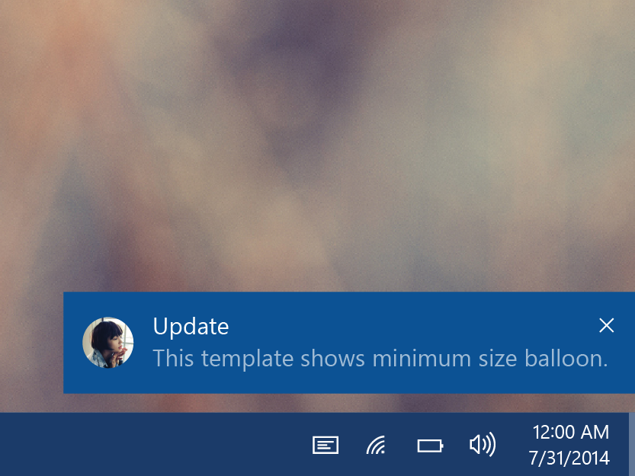
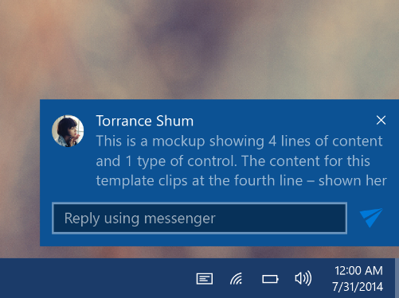
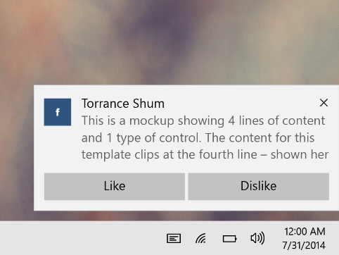
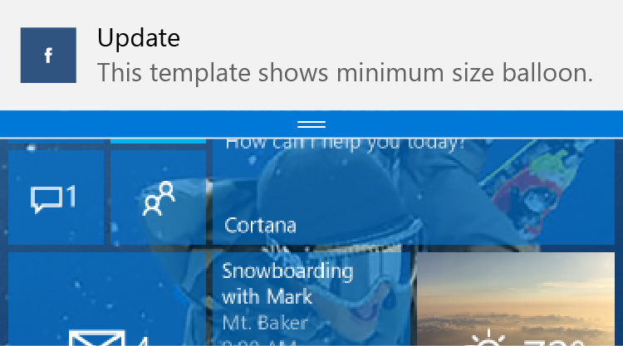
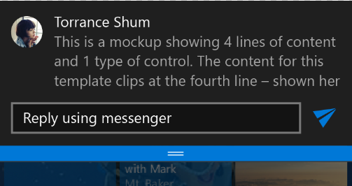
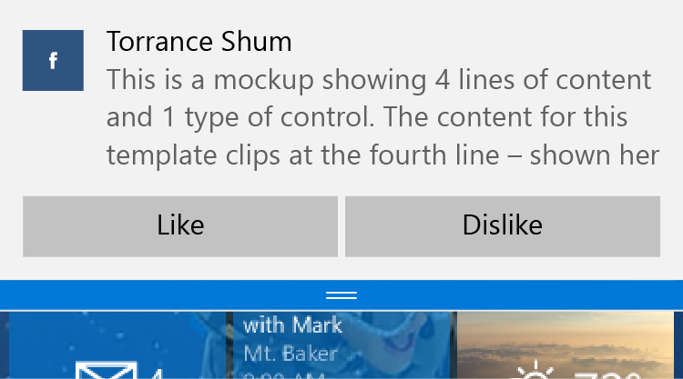
互動式 toast 通知
Desktop
Mobile

Slide 58
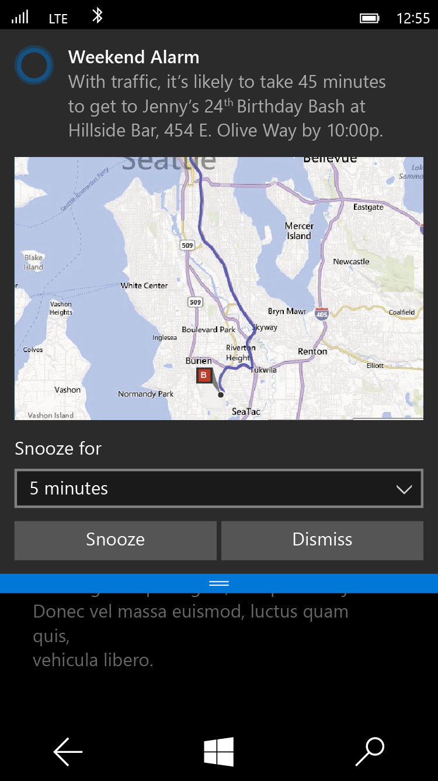
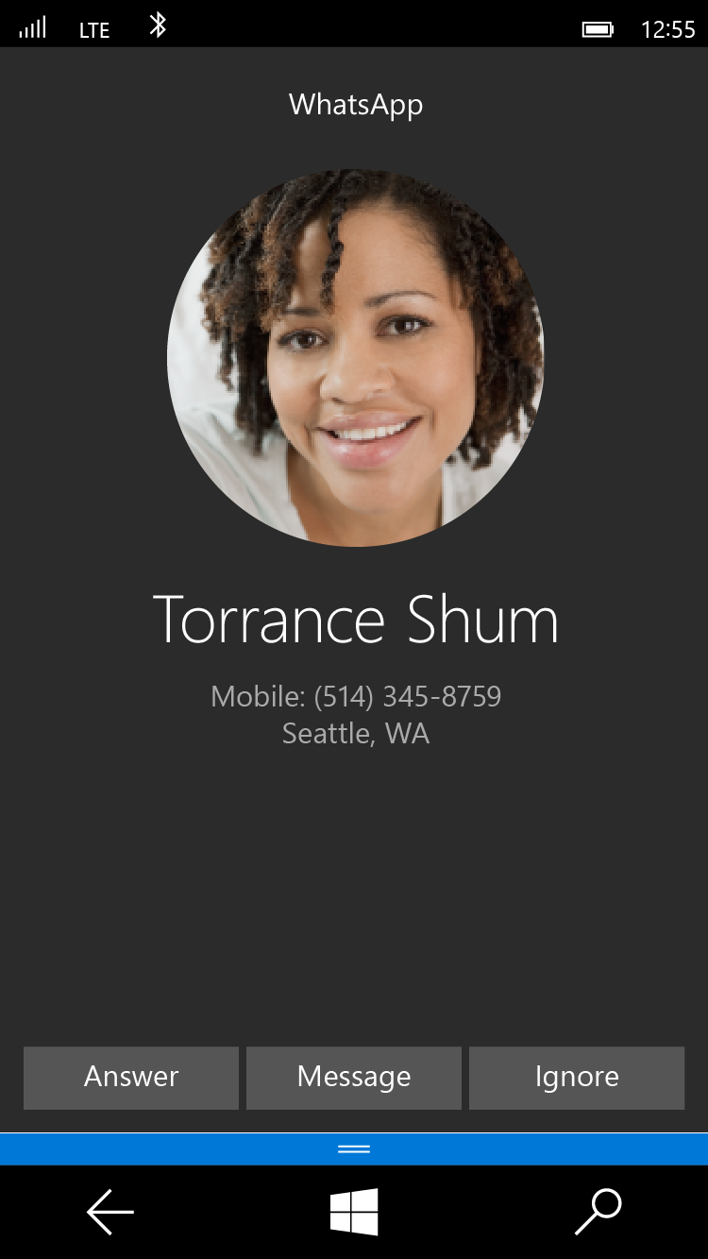
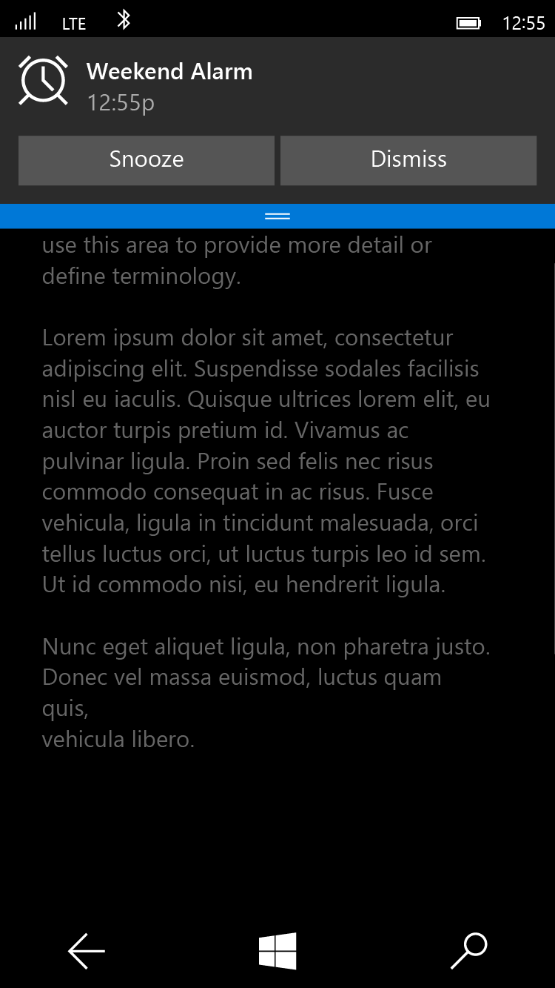
Special Toast Scenarios
Alarm
<toast scenario=“alarm”...>
Reminder
<toast scenario=“reminder”...>
Incoming Call
<toast scenario=“incomingCall”...>

Slide 59
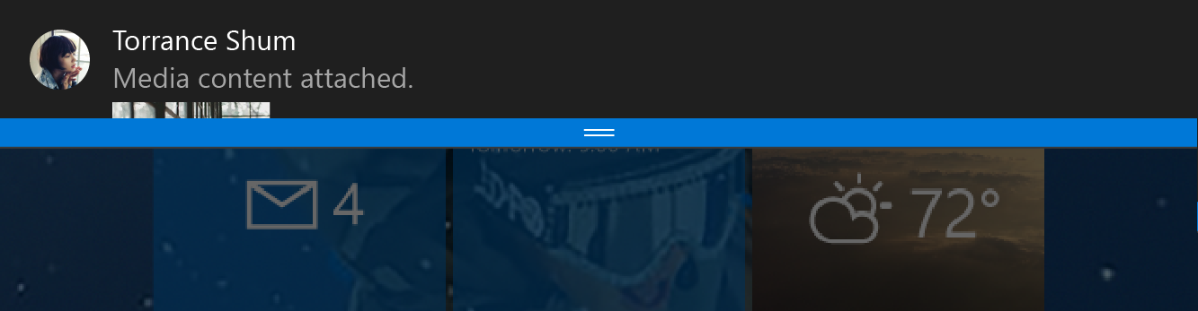
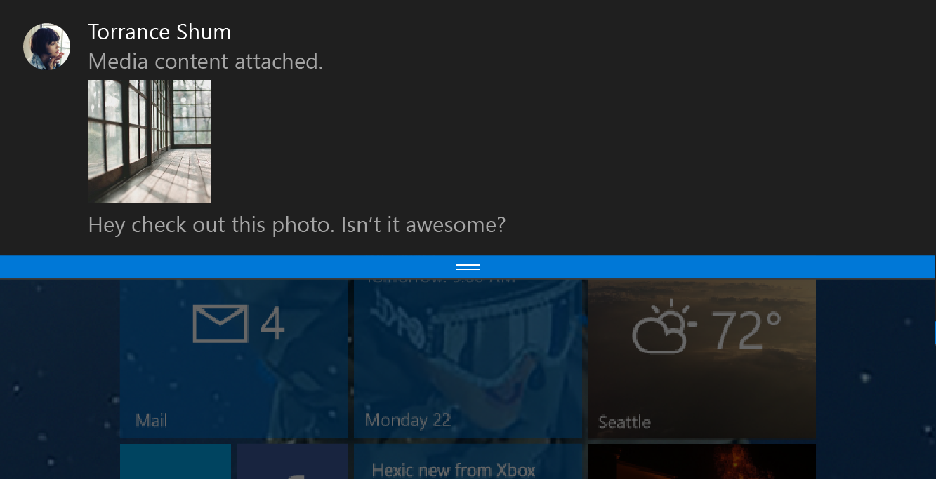
Toast notifications
<toast>
<visual>
<binding template="ToastGeneric">
<image placement="appLogoOverride"
src="Torrance Shum.png" />
<text>Torrance Shum</text>
<text>Media content attached.</text>
<image placement="inline"
src="attachment.png" />
<text>Hey check out this photo.
Isn’t it awesome?</text>
</binding>
</visual>
</toast>

Slide 60
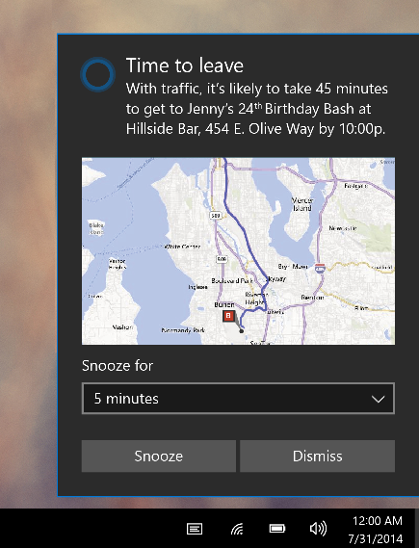
Toast input
<toast>
...
<actions>
<input title=“Snooze for” id="snoozeTime"
type="selections" defaultSelection=“5">
<selection id="5" content="5 minutes" />
<selection id="10" content="10 minutes" />
<selection id="20" content="20 minutes" />
</input>
...
</actions>
</toast>

Slide 61
Toast action
<toast>
...
<actions>
...
<action activationType="system" arguments="snooze" hint-inputId="snoozeTime" content=""/>
<action activationType="system" arguments="dismiss" content=""/>
</actions> </actions>
</toast>

Slide 62
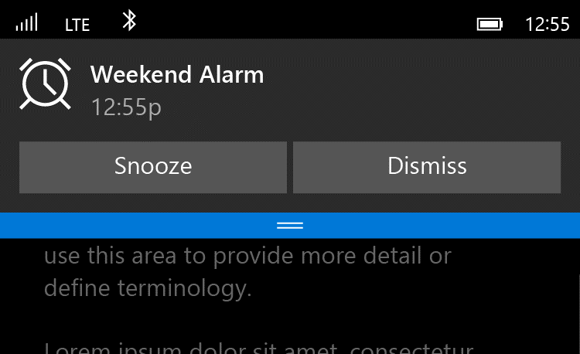
Alarms are Toasts
<toast scenario=“alarm”...>
<visual>
...
</visual>
<actions>
<action activationType='system' arguments='snooze' content='' />
<action activationType='system' arguments='dismiss' content=''/>
</actions>
</toast>

Slide 63
Toast customization
<toast>
...
<image placement="appLogoOverride" src="Logo.png" />
...
<actions>
...
<action activationType="background"
arguments="dismiss"
imageUri="send.png"
hint-inputId="1" />
</actions>
</toast>

Slide 64
New activation types & activations
<action activationType="foreground" />
<action activationType="background" />
<action activationType="protocol" />
<action activationType="system" />
Tap button
App launches
Retrieve Args
Take actions
Tap button
Task launches
Retrieve Args
Take actions
Tap button
Protocol activates
Web / app
Tap button
System handles

